Slide 1
DBMS MINI PROJECT
E-commerce website
Presented By
Mr. Prajwal R USN: 1BY18IS084
Ms. Rashmi B S USN: 1BY18IS098
Under the guidance of
Prof. Drakshaveni G
Assistant Professor
BMSIT&M

Slide 2
CONTENTS
Introduction
Aim
Schema Diagram
Description
Tools Used
Screenshots

Slide 3
INTRODUCTION
Ecommerce is a process of doing business through computer networks.
The primary goal of an e-commerce site is to sell goods and services online.
The basic concept of the ecart is to allow the customer to shop virtually and buy the item of their desire from the e-commerce site.

Slide 4
AIM
Buying online makes people’s life easier by reducing their physical work and save travel time.
Also enables consumers to shop or do transactions 24 hours a day, all year round from almost any location.
Ecart provides consumers with choices.

Slide 5
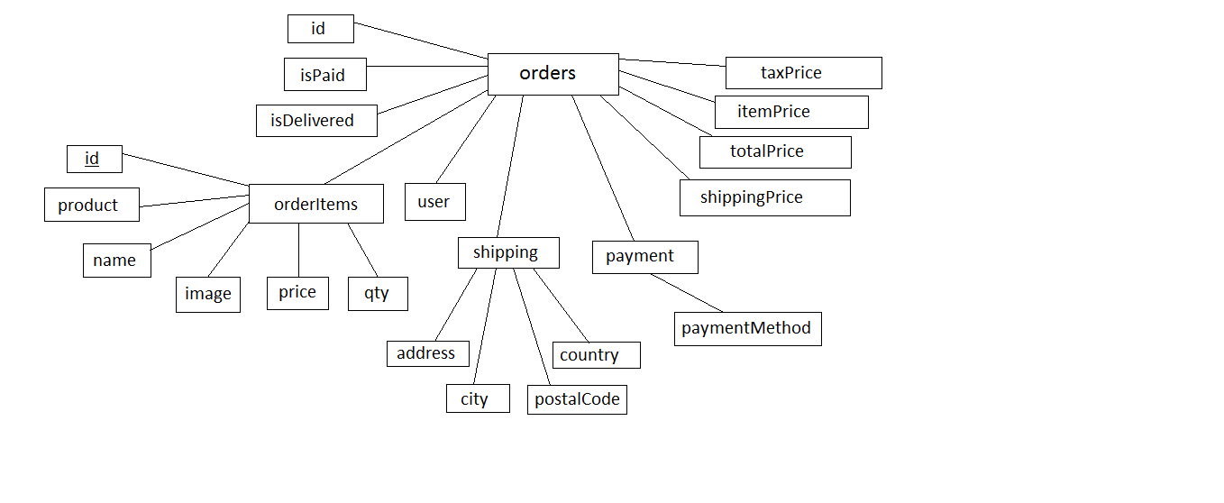
SCHEMA DIAGRAM

Slide 6
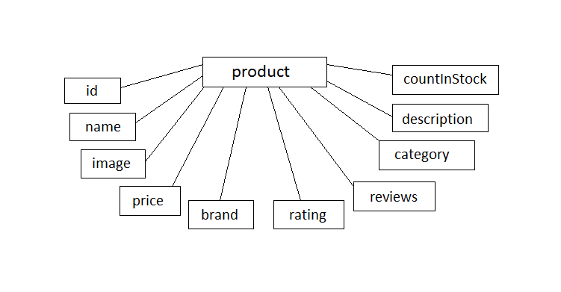
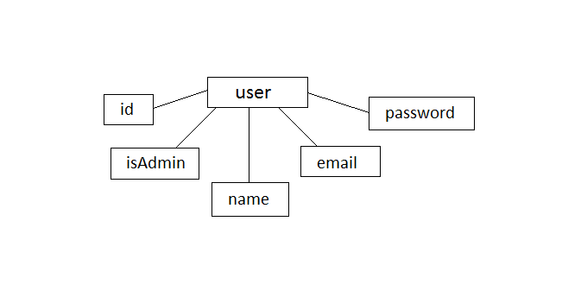

Slide 7
DESCRIPTION
A new user can register on the website.
User can see details of the product.
User can view his order history.
User can view the products by choosing categories.
User can add or delete a product from the cart.
A user can update his details.
User can view the total price of product present in the cart unpurchased.
Admin can add or delete products.
Admin can view the ordered product details.

Slide 8
TOOLS USED
languages used : Javascript,css,html
Database : Mongodb
frontend : React js
backend api : Node js
framework : Express js
Text editor : Visual Studio

Slide 9
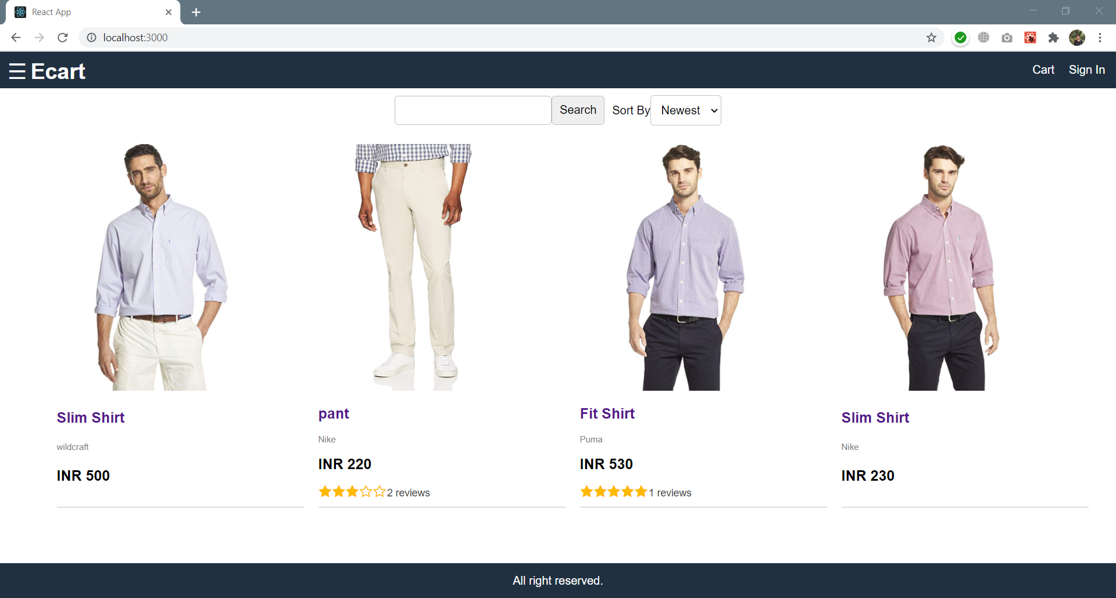
SCREENSHOTS

Slide 10
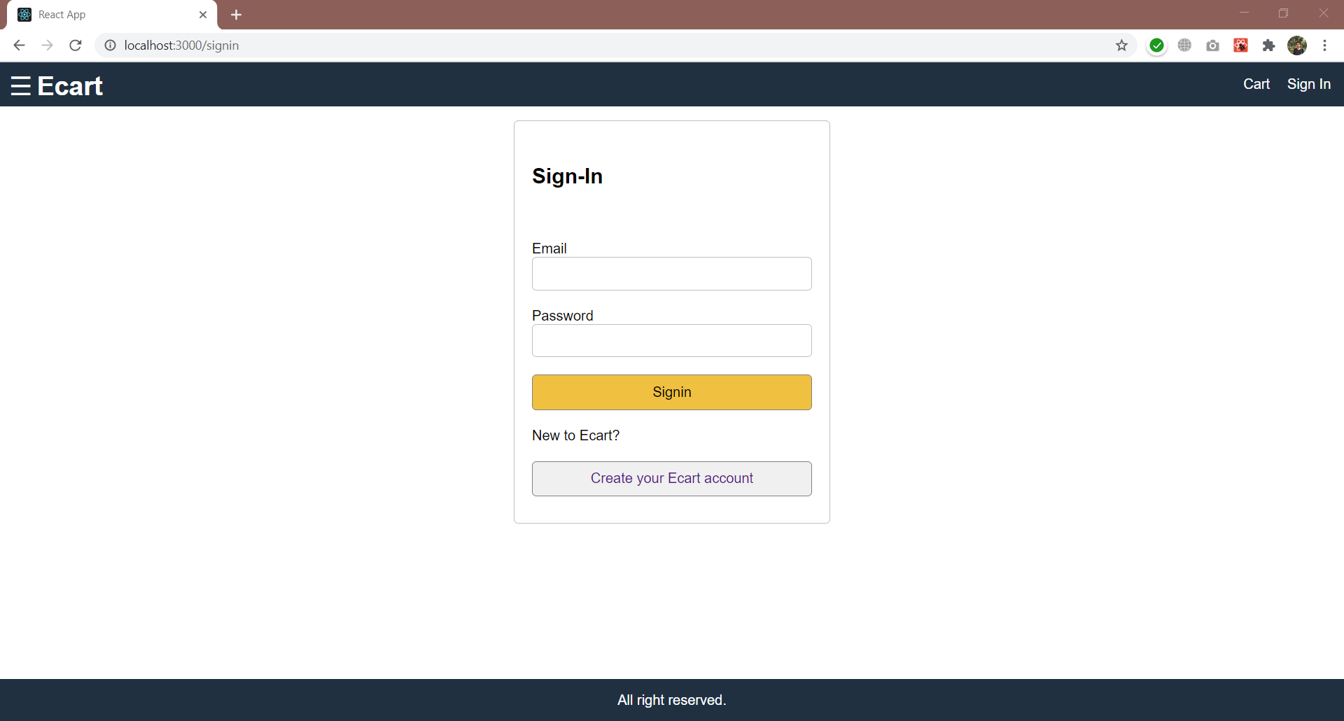

Slide 11
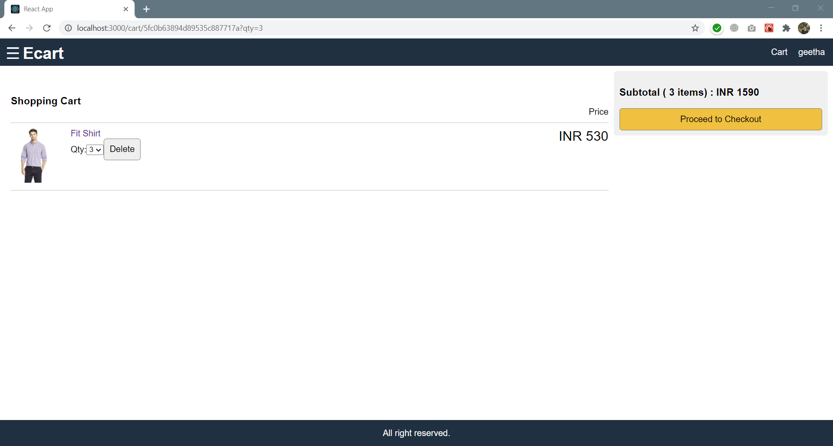

Slide 12
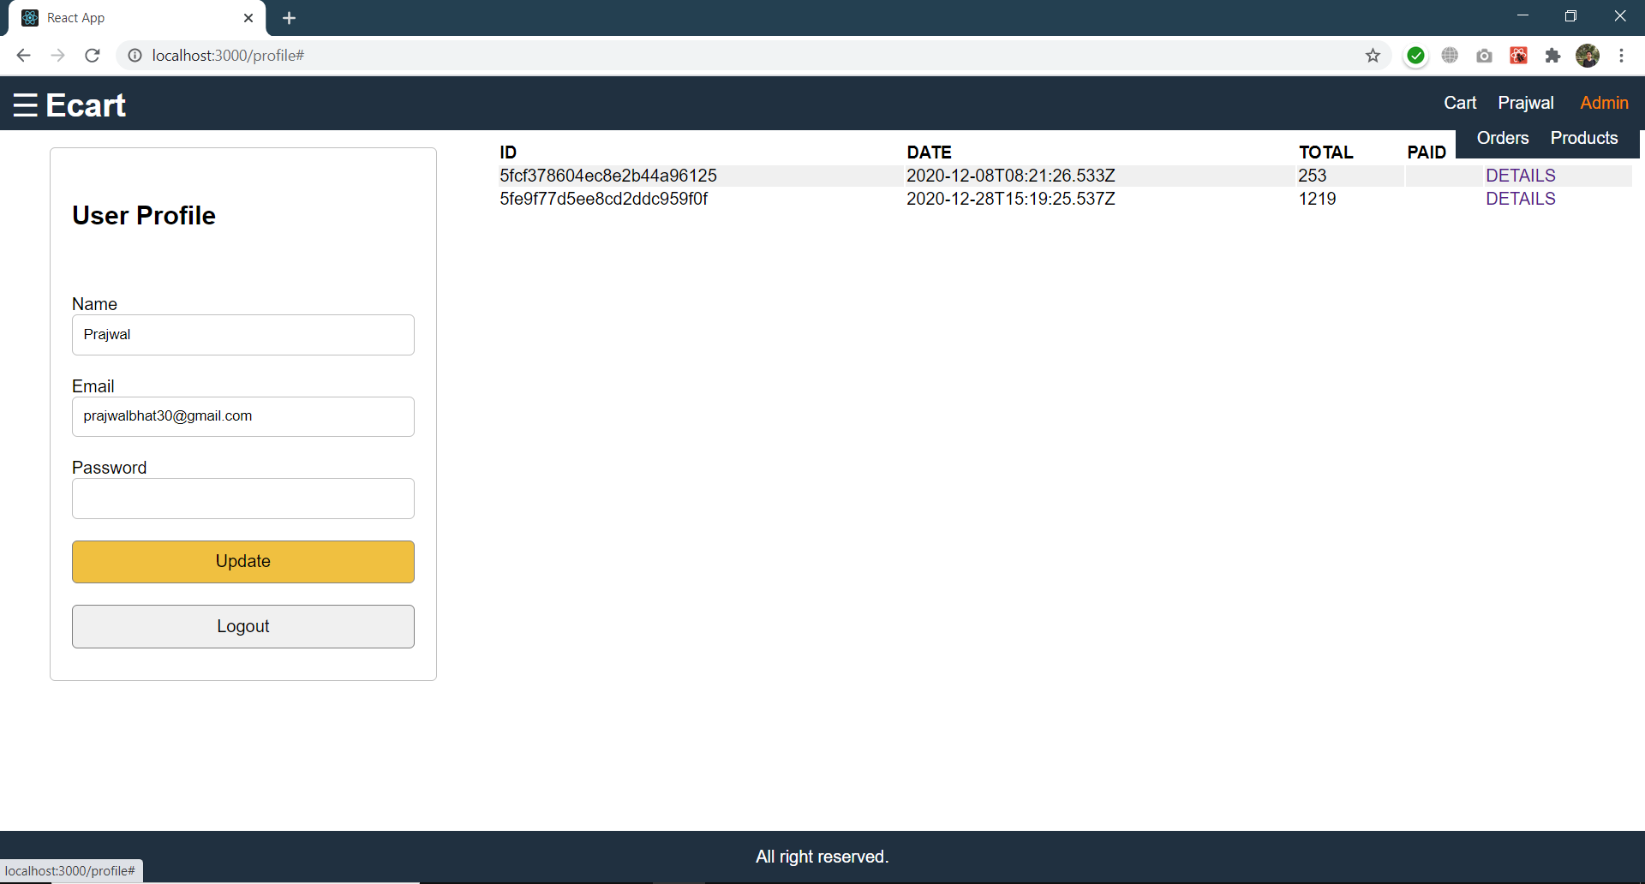

Slide 13
Thank you

